Slide 1

Titanic trouble
Laura Williams
July 20, 2020

Slide 2
Why the titanic?
This pun: ML exposure in this class is only the tip of the iceberg!
Nephew is obsessed with the Titanic; starting to learn code
Titanic movie parody: Thumbtanic (youtube)
But really…
Beginner level machine learning problem
Something I could continue working on
Kaggle Titanic: Machine Learning from Disaster Competition
Predict survival on the Titanic and get familiar with ML basics
On April 15, 1912, during her maiden voyage, the Titanic sank after colliding with an iceberg, killing 1502 out of 2224 passengers and crew = 32% survival rate.

Slide 3
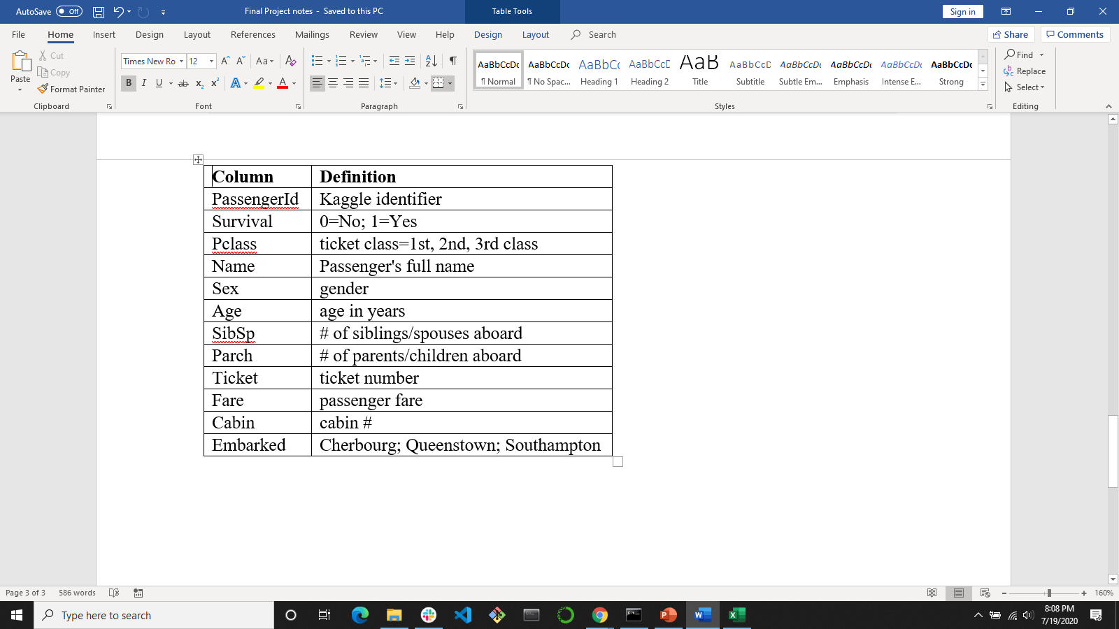
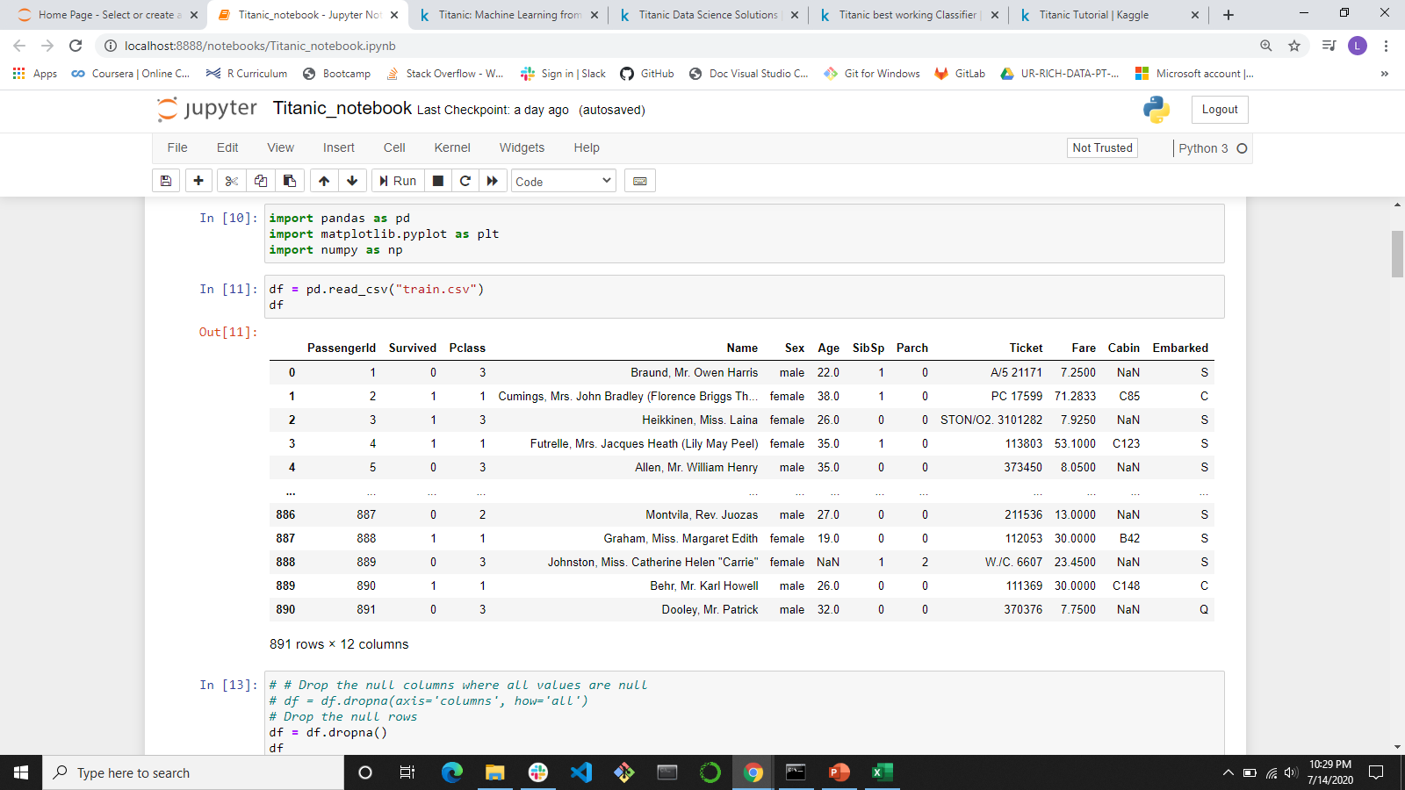
Titanic Dataset
Kaggle datasets (https://www.kaggle.com/c/titanic)
train.csv – train-test split
891 rows
12 columns
test.csv – no Survival

Slide 4
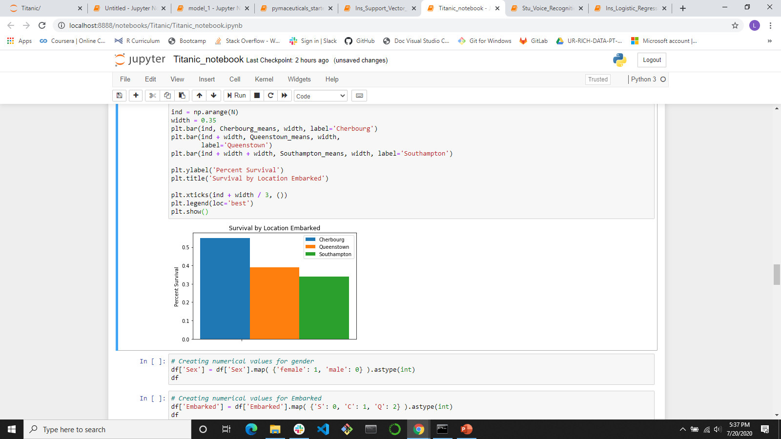
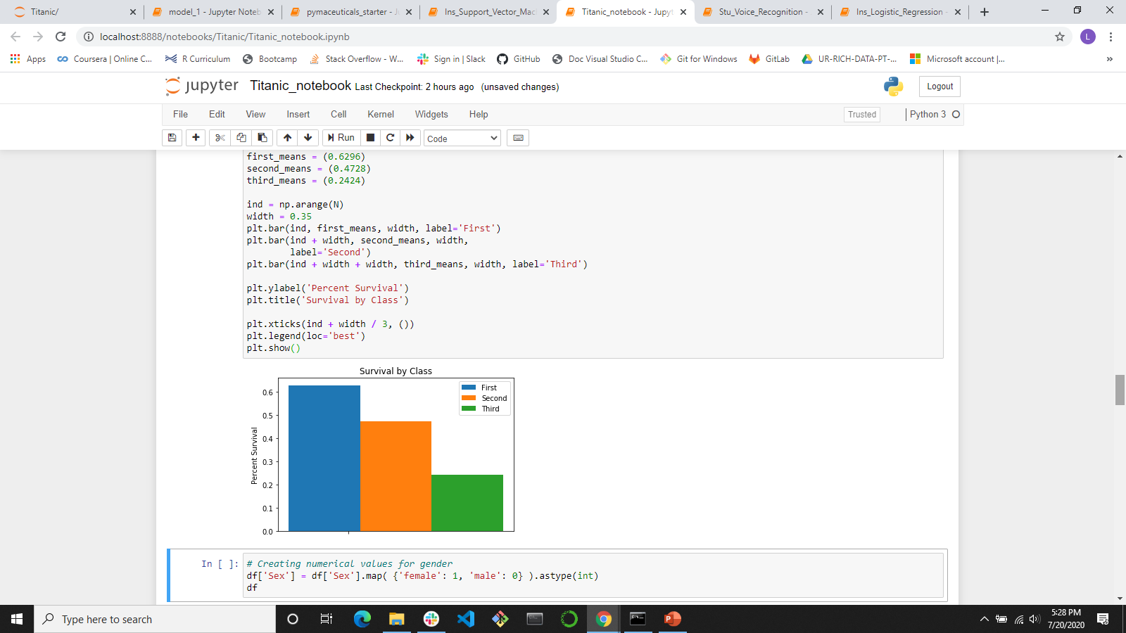
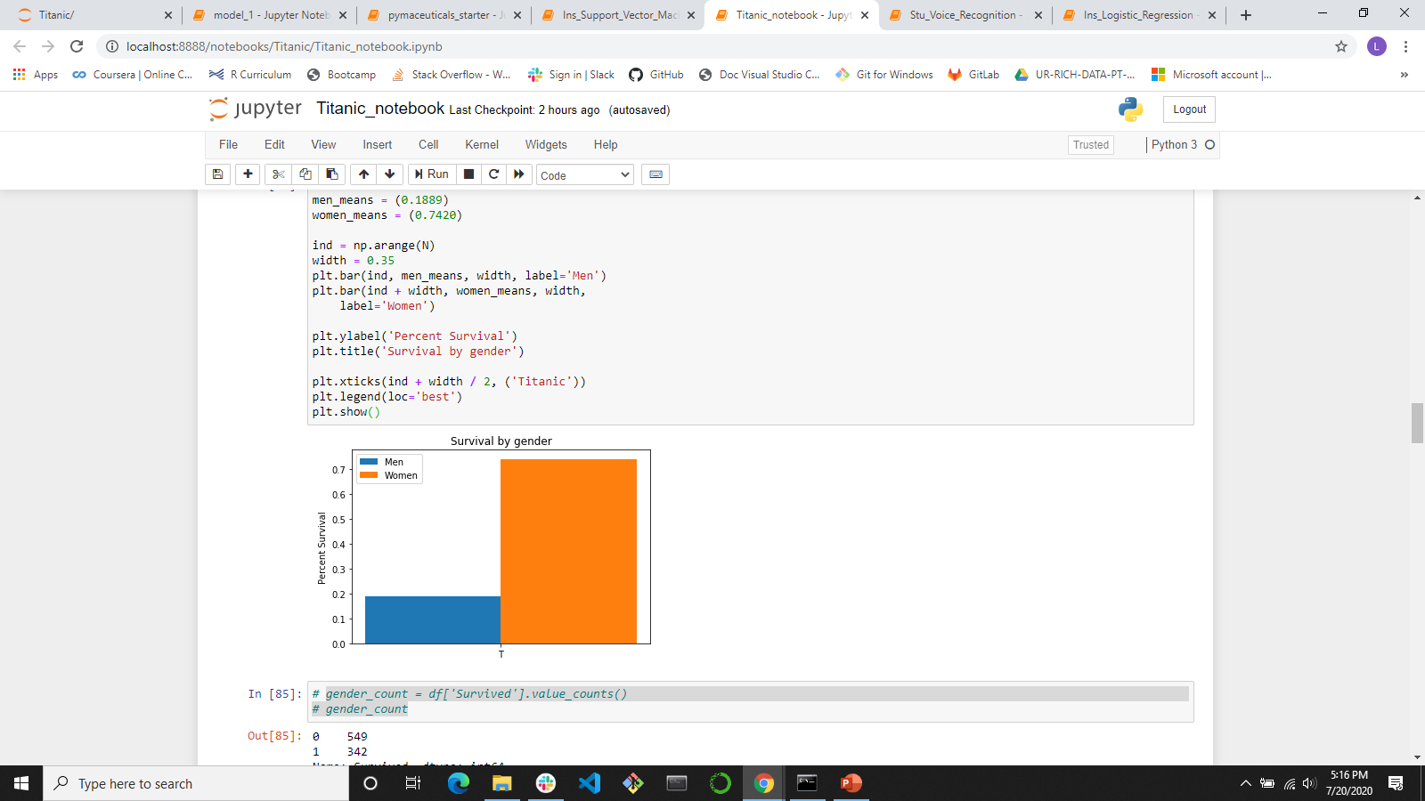
What’s the data look like?

Slide 5
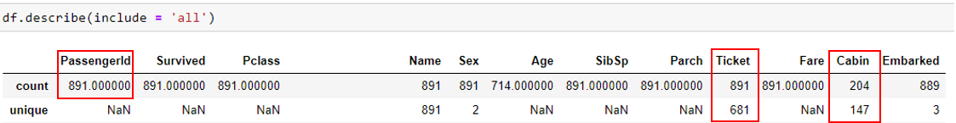
Cleaning the data for modeling
correcting aberrant values and outliers,
completing missing information,
creating new features for analysis, and
converting fields to the correct format for calculations
Dependent (y): Survived
Independent (X) Drop – not likely to have a large impact on the outcome
PassengerId: Random unique identifier created by Kaggle
Ticket: Random unique identifier
Cabin: 687 rows missing; 147 unique values

Slide 6
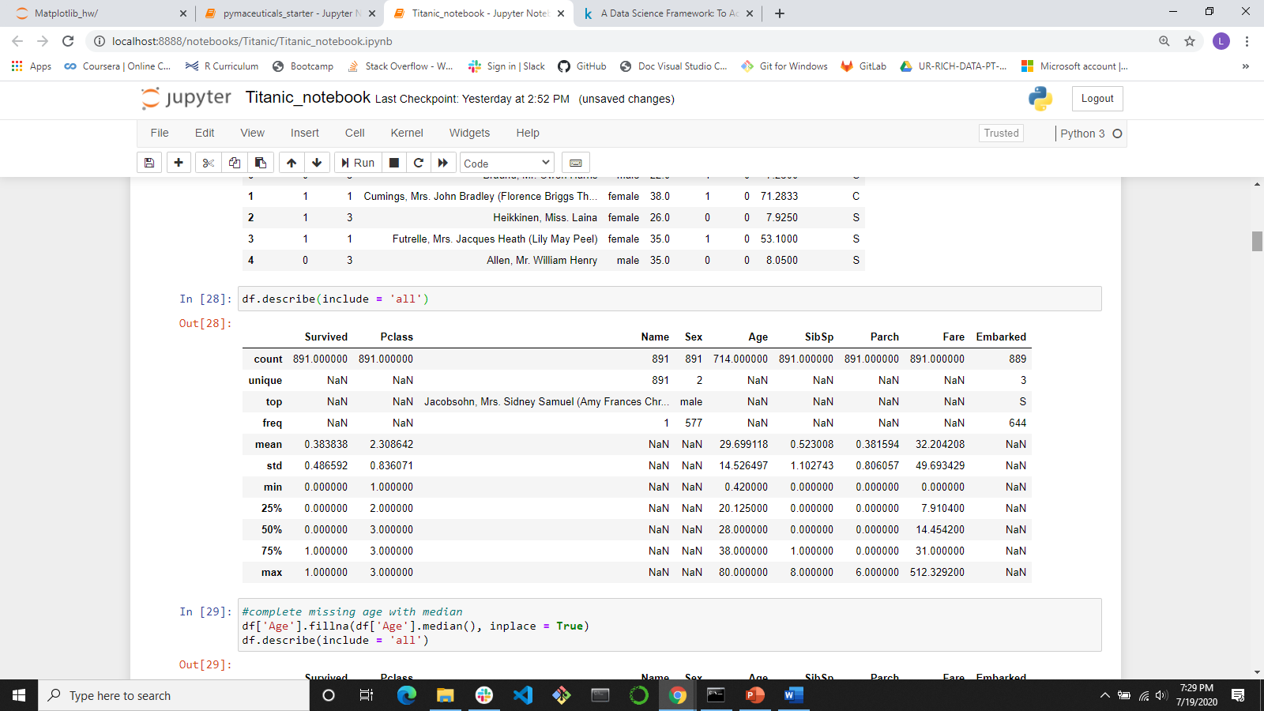
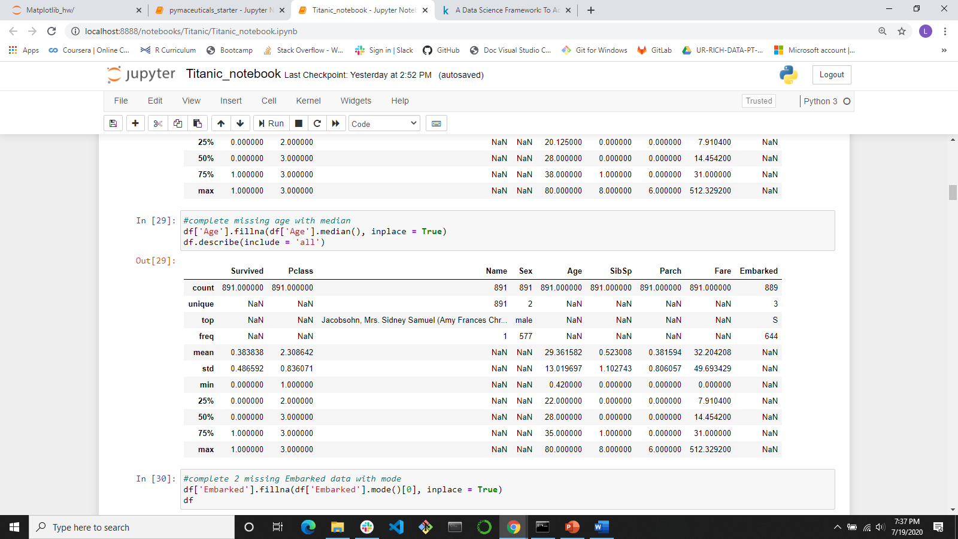
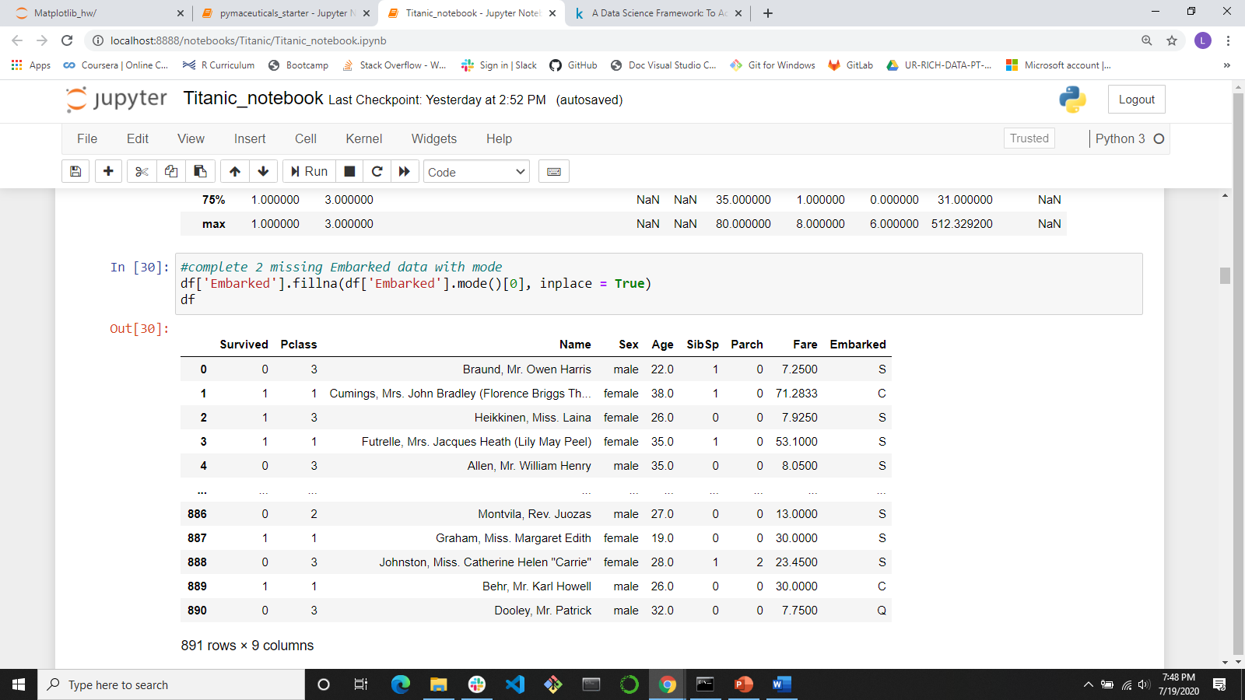
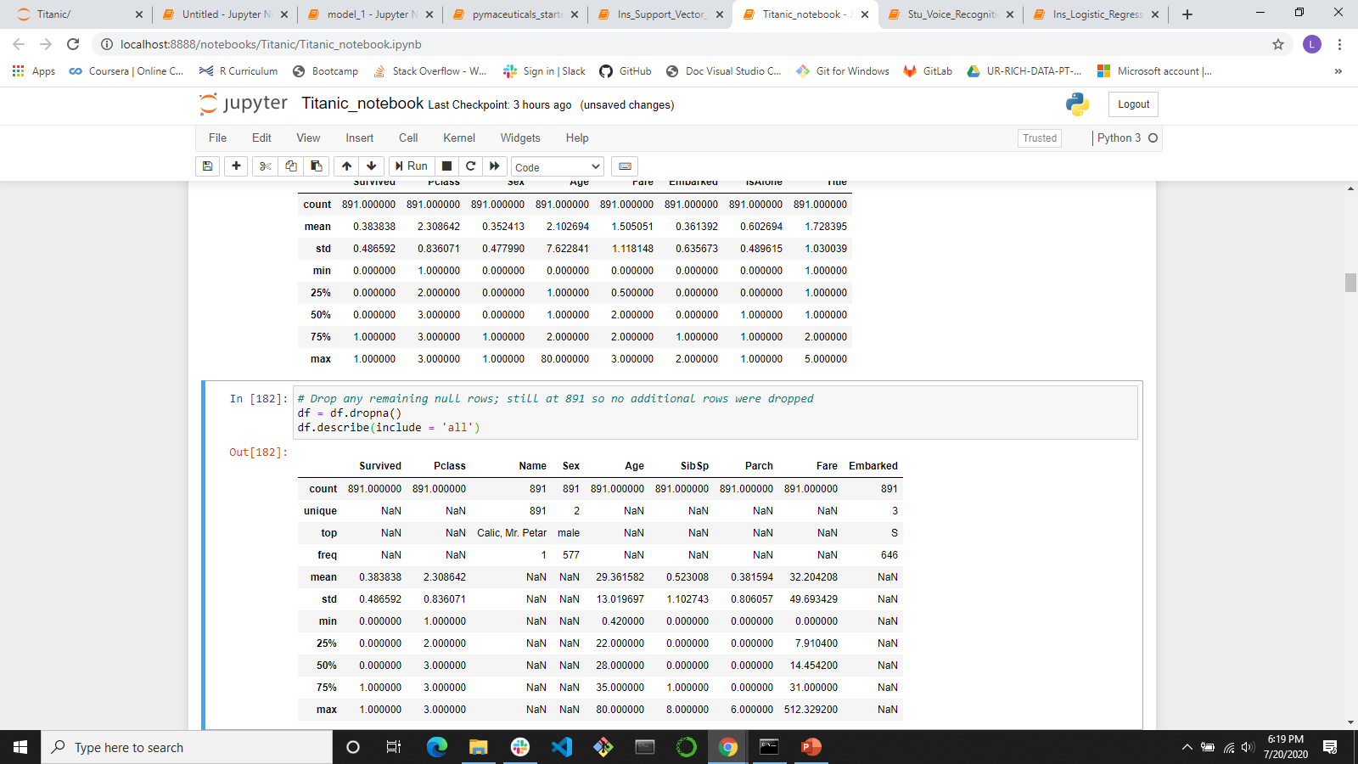
Cleaning the data for modeling
Independent (X) Keep:
Age: 177 missing values; how to complete the data?
fill in with median value
Embarked: 2 missing values; how to complete the data?
fill in with mode value
Pclass: ordinal number; good info

Slide 7
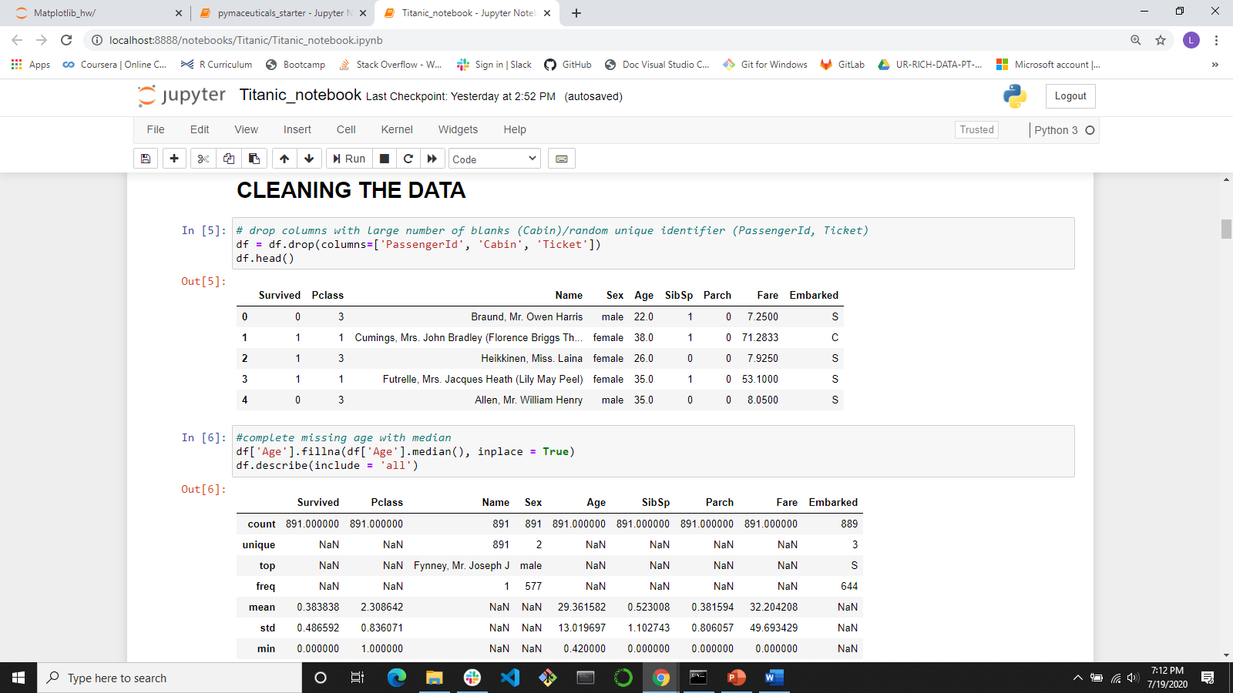
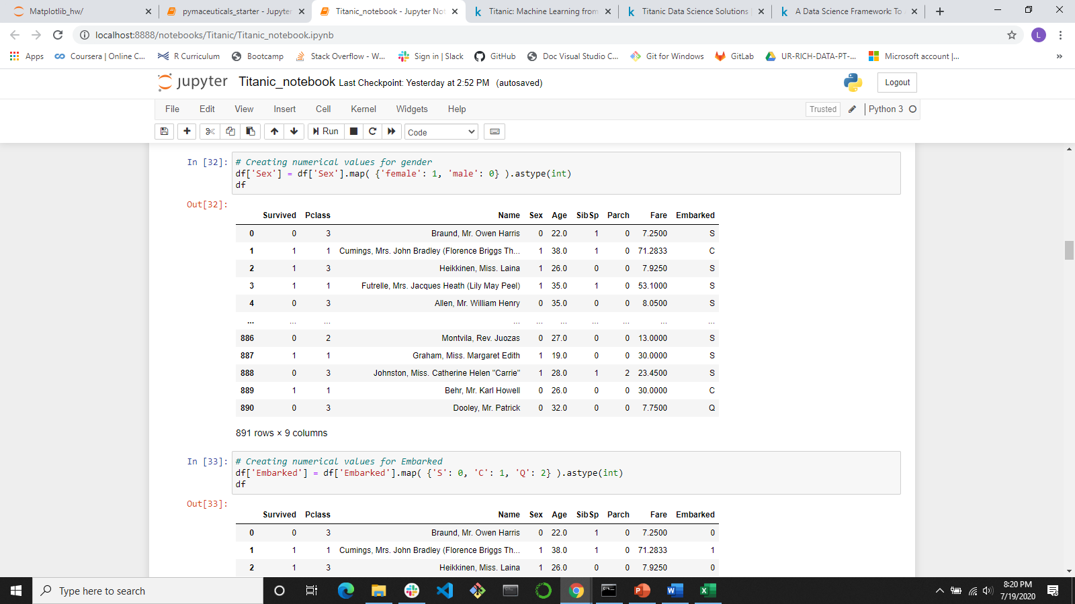
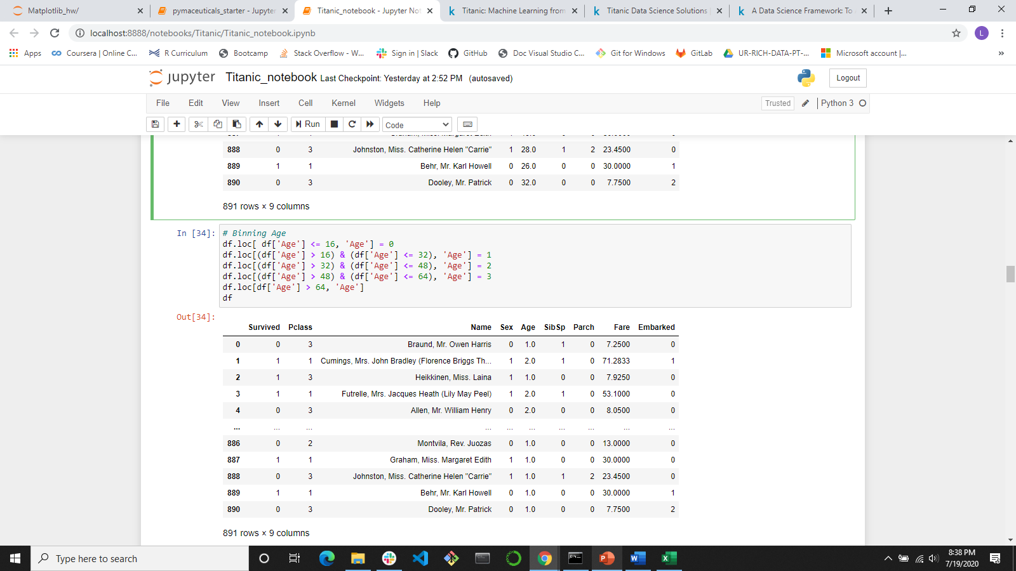
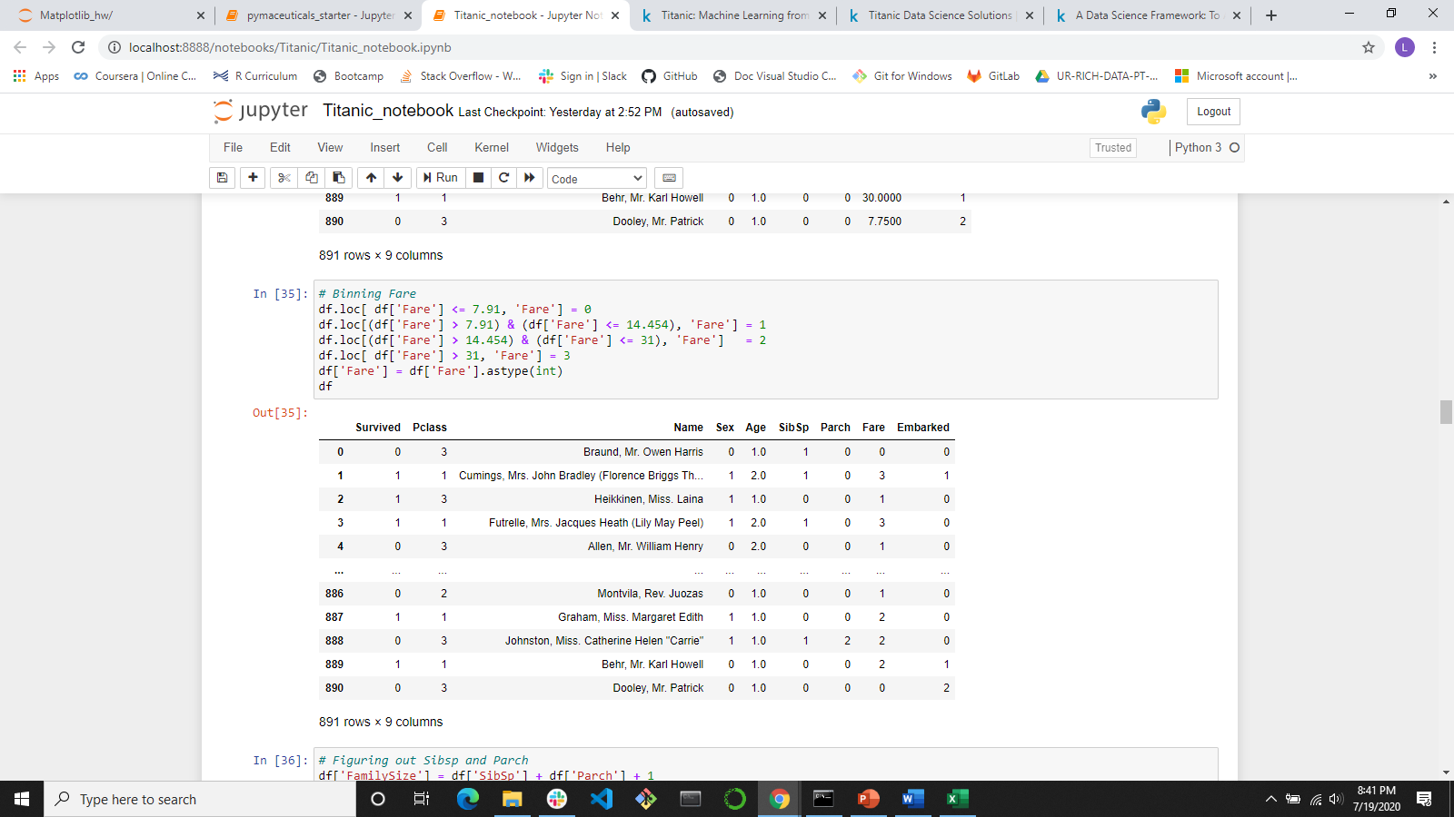
Cleaning the data for modeling
Independent (X) Keep:
Sex: convert
Female: 1
Male: 0
Embarked: convert
Southampton (S): 0
Cherbourg (C): 1
Queenstown (Q): 2
Age: continuous variable; convert
Bin age groups
Set age groups to numeric
Fare: continuous variable; convert
Same as above for Age

Slide 8
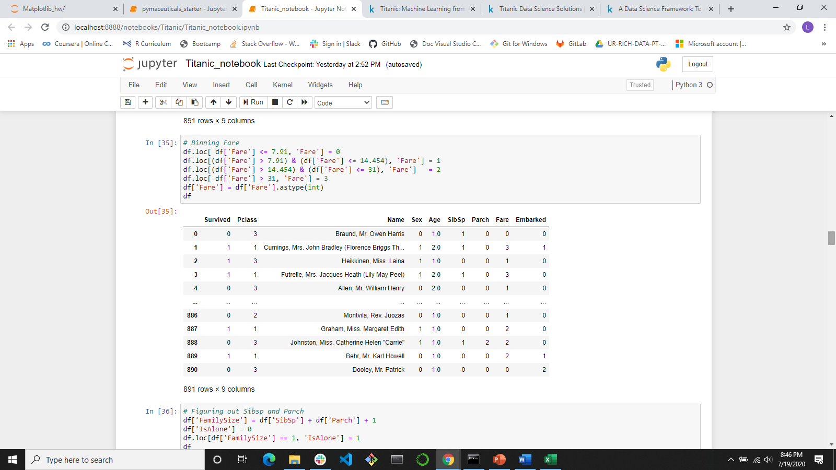
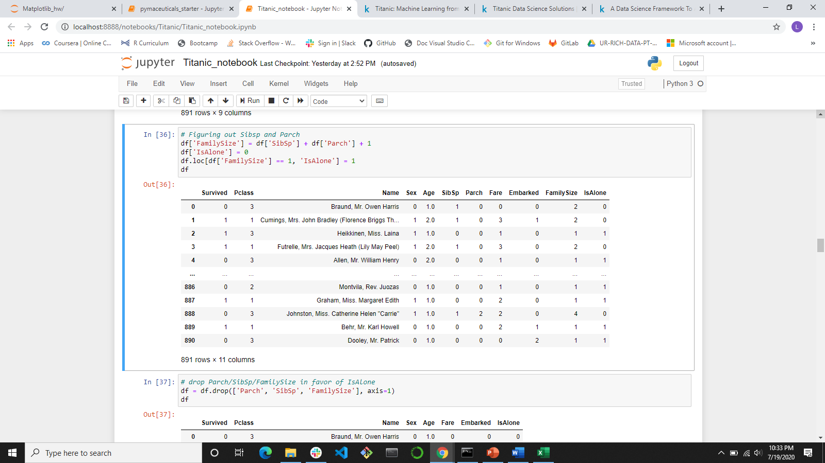
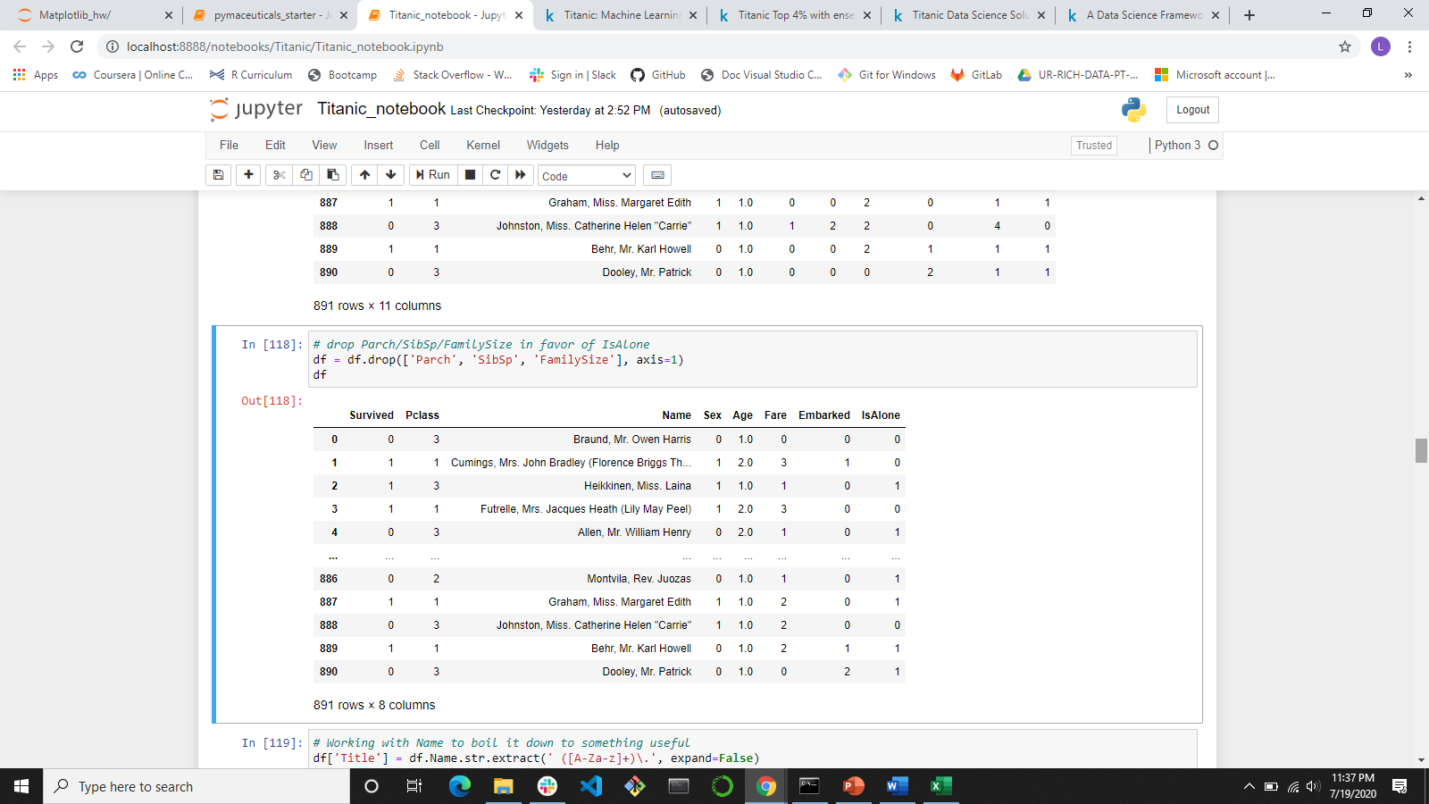
Cleaning the data for modeling
Independent (X) Keep:
SibSp/Parch = how many relatives are onboard
Create IsAlone, where 0 = alone; 1 = one relative or more onboard
Drop FamilySize, SibSp and Parch

Slide 9
Ready to model!
What model do I pick?
Supervised Learning: Classification or Regression?
Classification: predicting a categorical outcome
Decision Tree: Accuracy Below 79% - Drop
Random Forest: Accuracy Above 79% - Keep
Logistic Regression: Accuracy Below 79% - Drop
KNearest Neighbor: Accuracy Above 79% - Keep
What model do I pick?
Supervised Learning: Classification or Regression?
Classification: predicting a categorical outcome
Decision Tree
Random Forest
Logistic Regression
KNearest Neighbor
Next Step:
Random Forest: run GridSearch for parameter tuning
KNearest Neighbor: determine best k
Run Classification report on both and compare

Slide 10
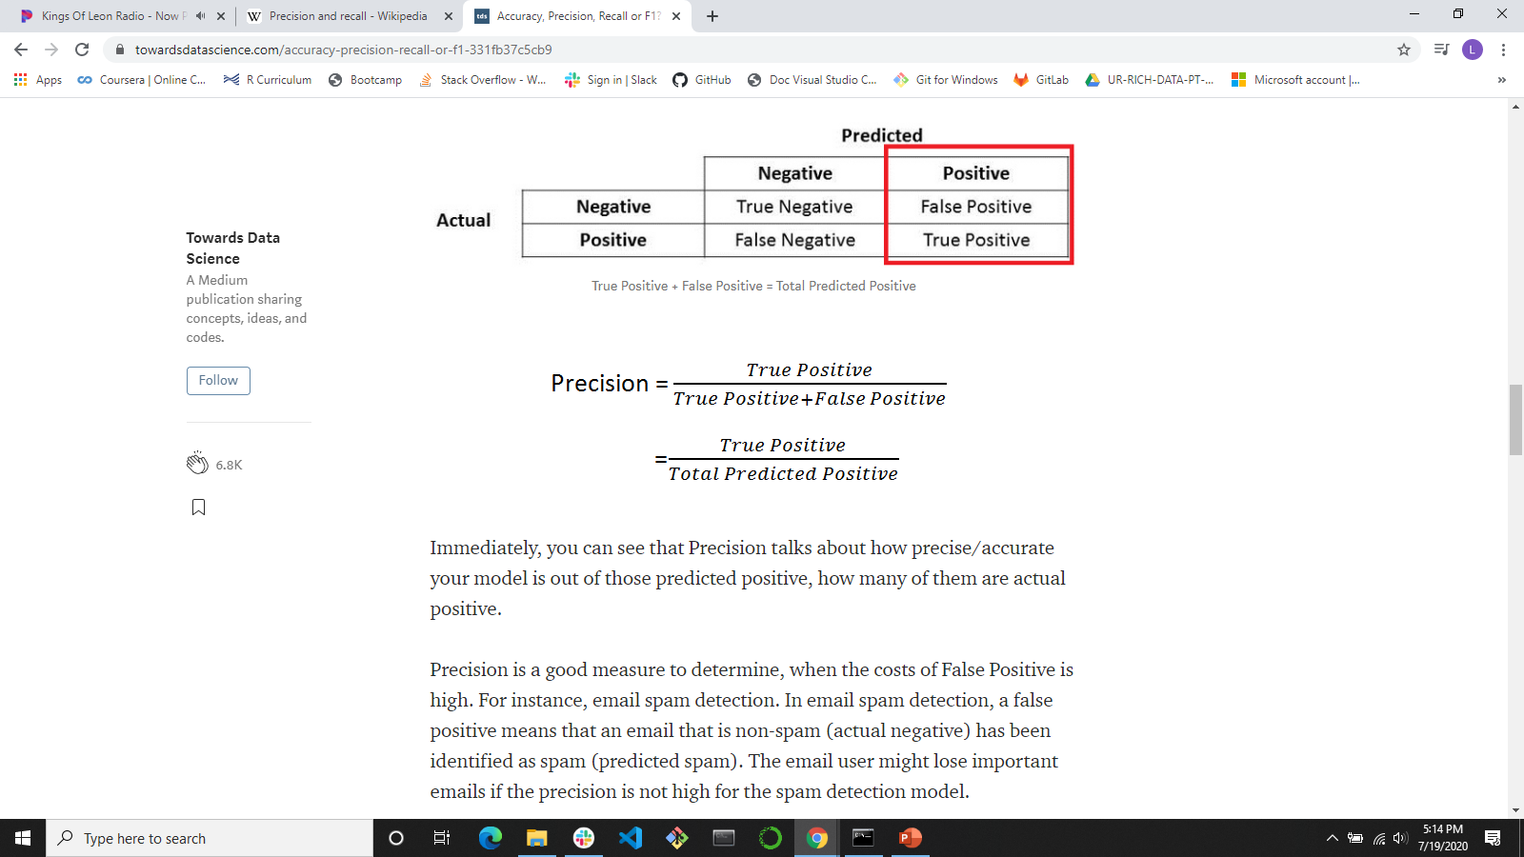
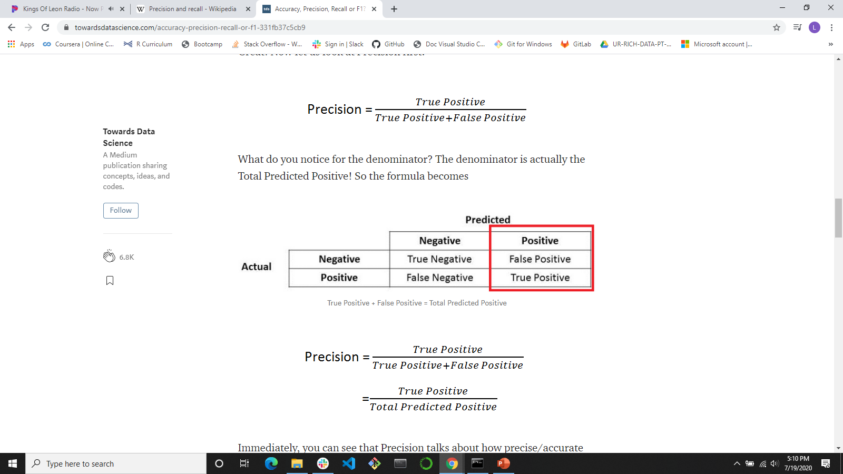
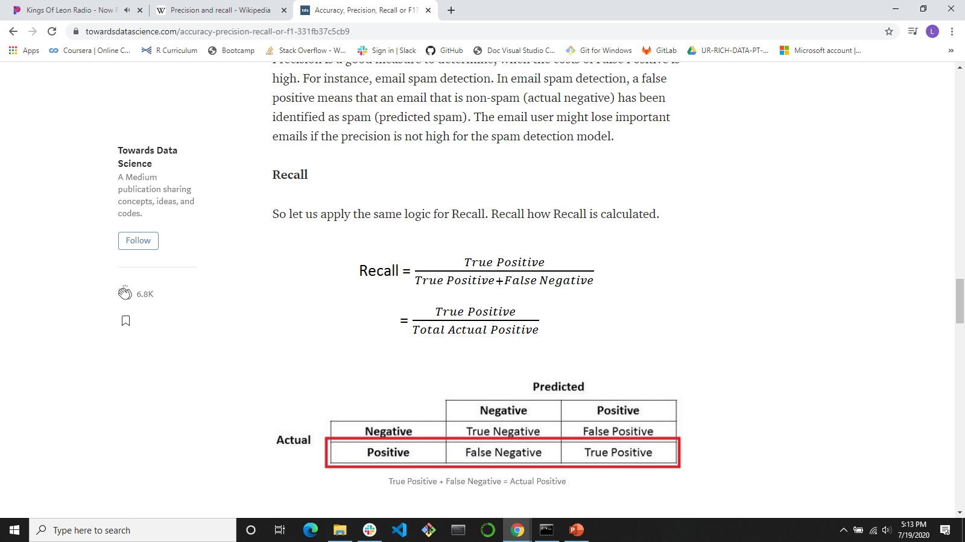
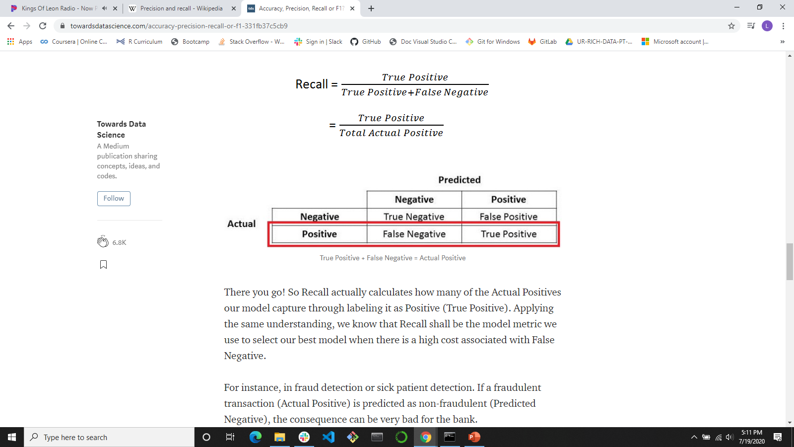
Best-Fit model?
Accuracy, Precision, Recall
Where 0 = Died; 1 = Lived
Precision: True Positive/Total Predicted Positive
Actually died/Model Predicted to die
Actually lived/Model Predicted to live
Recall: True Positive/Total Actual Positive
Model predicted correctly died/Total Actually died
Model predicted correctly lived/Total Actually lived
https://towardsdatascience.com/accuracy-precision-recall-or-f1-331fb37c5cb9

Slide 11
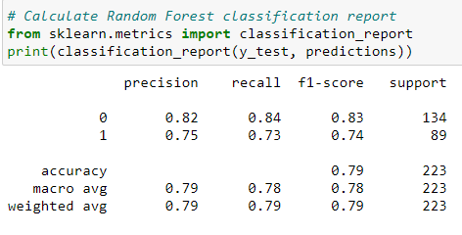
Best-Fit model?: Random Forest
Where 0 = Died; 1 = Lived
Accuracy: 79%
Precision:
True Positive/Total Predicted Positive
82%: Actually died/Model Predicted die
75%: Actually lived/Model Predicted live
Recall:
True Positive/Total Actual Positive
84%: Model predicted correctly died/Total Actually died
73%: Model predicted correctly lived/Total Actually lived

Slide 12
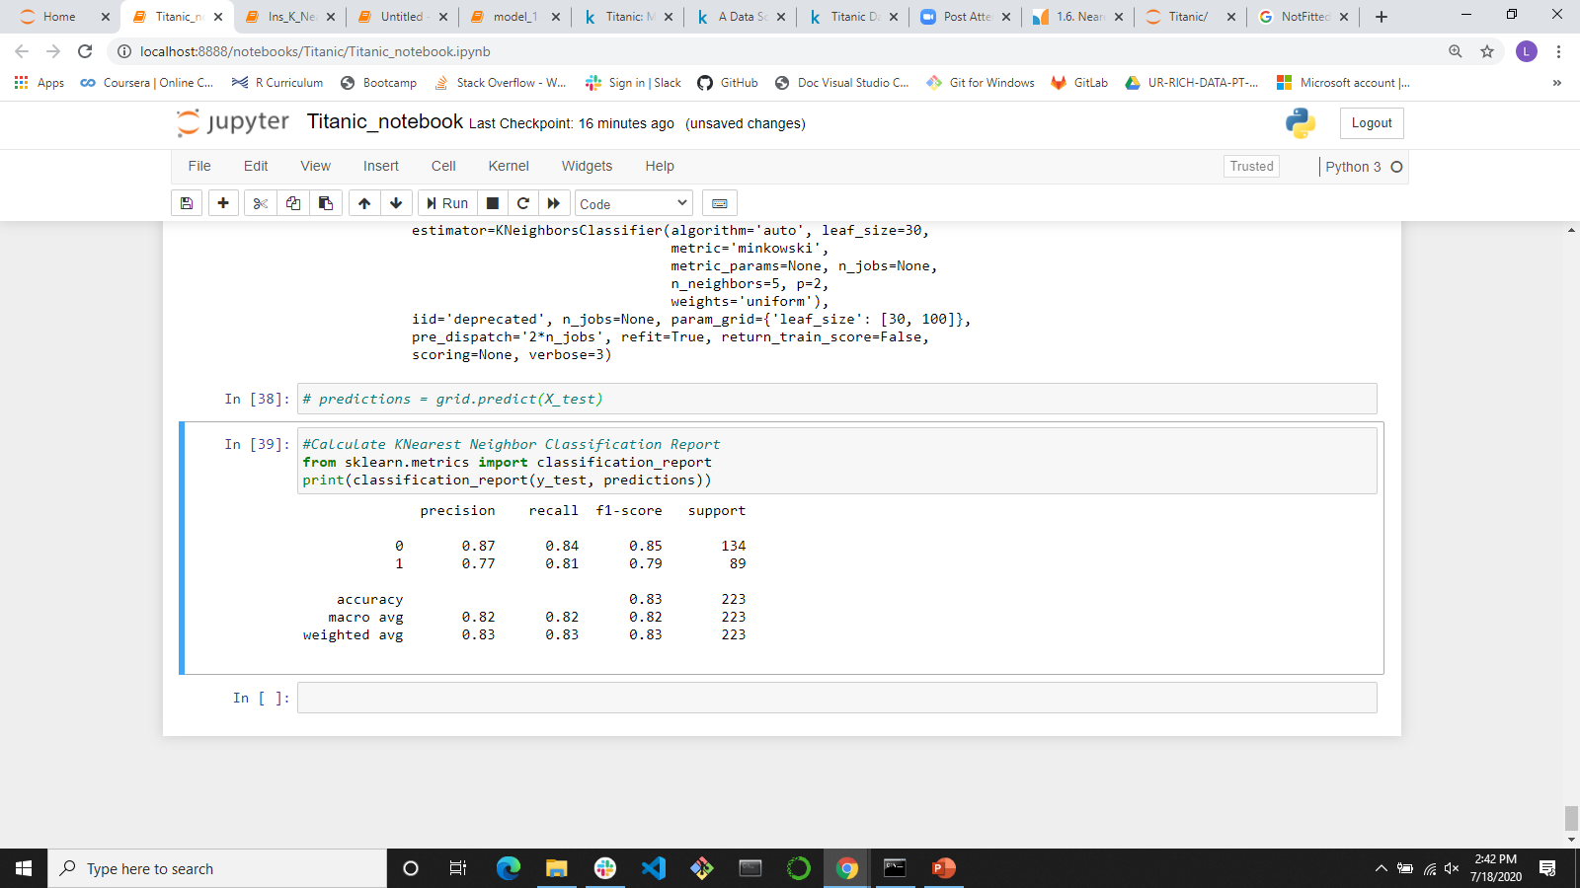
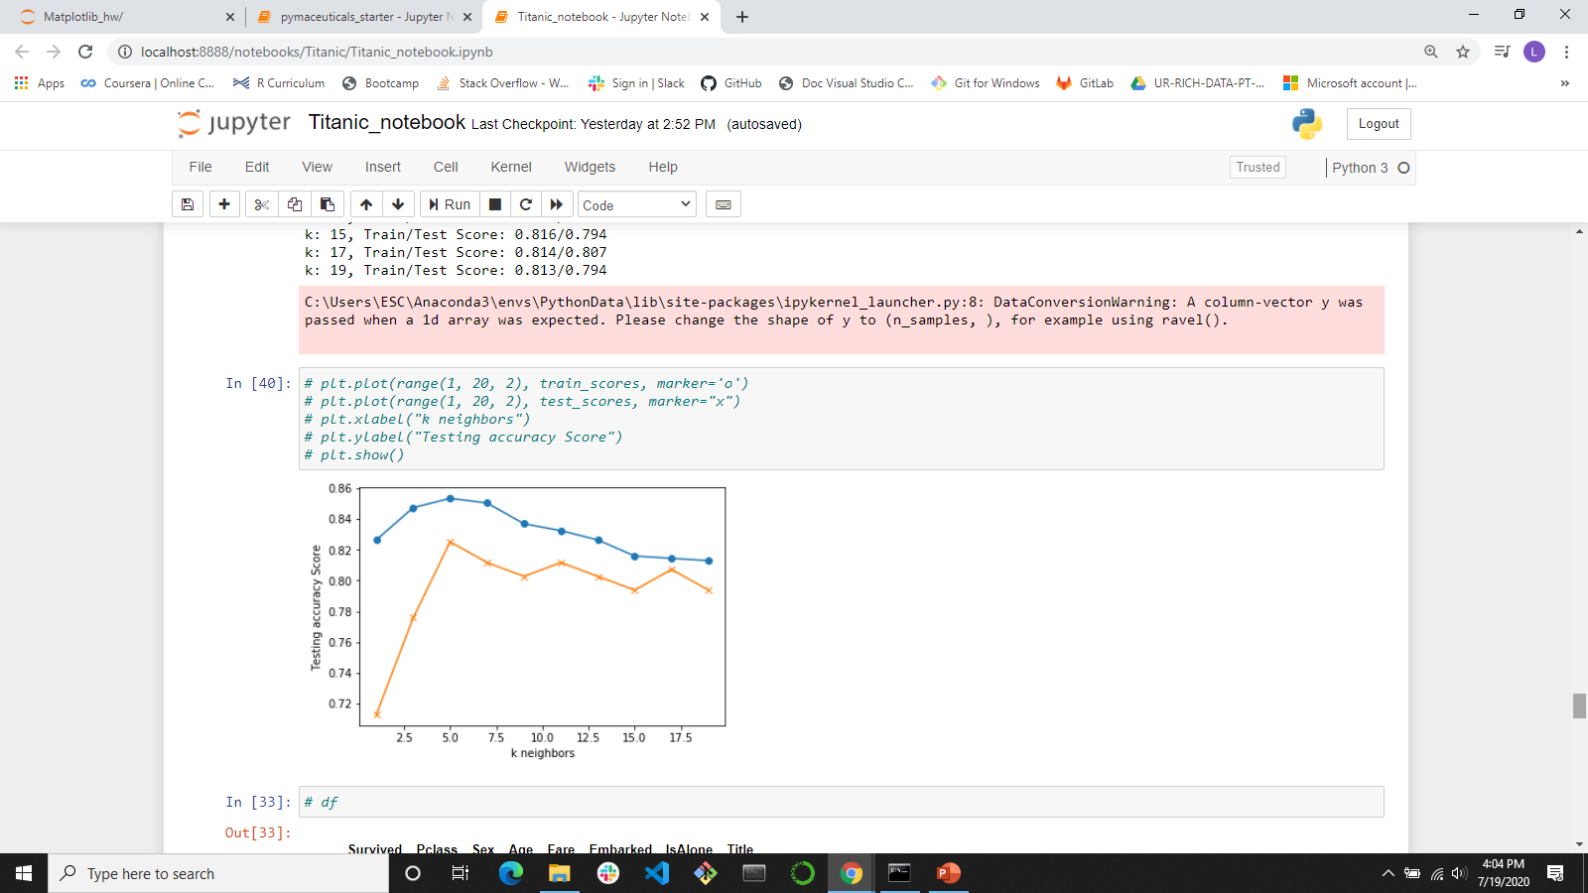
Best-Fit model?: Knearest neighbor
Where 0 = Died; 1 = Lived
Accuracy: 83%
Precision:
True Positive/Total Predicted Positive
87%: Actually died/Model Predicted die
77%: Actually lived/Model Predicted live
Recall:
True Positive/Total Actual Positive
84%: Model predicted correctly died/Total Actually died
81%: Model predicted correctly lived/Total Actually lived
K = 5 best fit

Slide 13
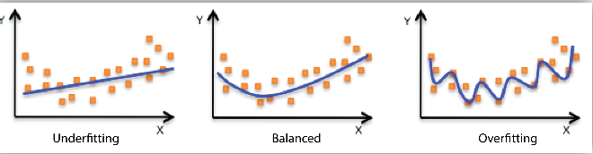
Lessons Learned
Iceberg, Straight Ahead!
Survey and understand your data/datatypes before jumping into modeling
4 C’s of Cleaning: Correct, Complete, Create, Convert
Next Steps
Keep going…
Re-examine X features: Name, Family size (SibSp/Parch)
Try ensemble modeling
Make a submission to the competition – test.csv
Try other competitions!

